Slide 1

Improving Grocery Shopping Experience
Jumbo Project Green and Yellow Teams

Slide 2

The Scope
Focus on in-store shopping
Technical Solution
Part of existing application
Jumbo Customers
Dietary restrictions
Allergies
Other Preferences

Slide 3

Goals
Minimize label reading
Cater to “minorities” needs
Find products using AR navigation to products categories
Speed up the check out
Notes:
To improve grocery shopping experience for all Jumbo customers

Slide 4
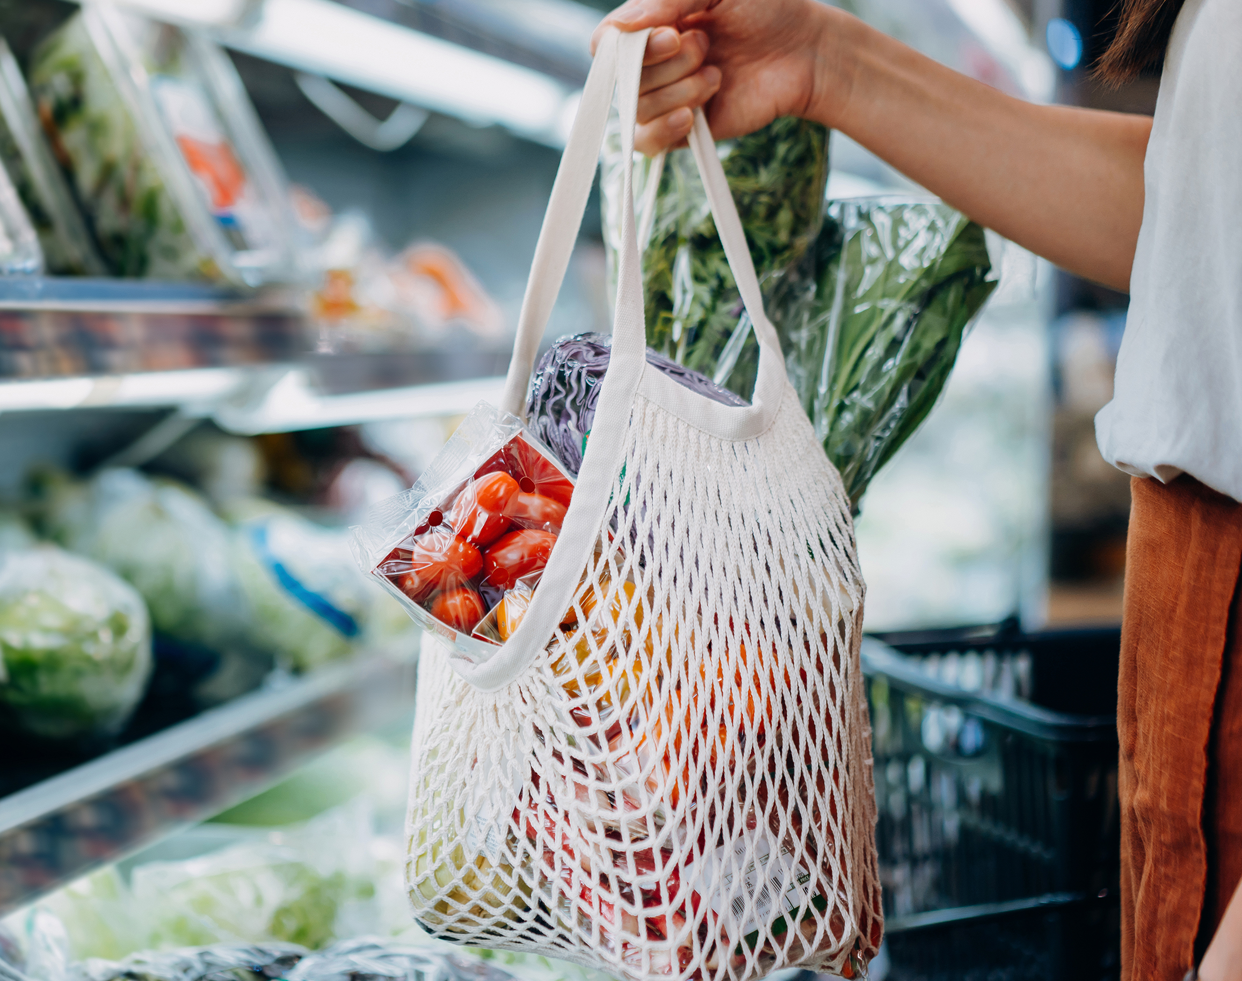
Solution
Let’s go shopping!

Slide 5

Reflection
Struggled presenting our ideas
Proud of solution:
Nice design
Great collaboration and teamwork
Good execution and functionality
Positive impact
Good communication with stakeholders
Well received
Notes:
Struggled presenting our ideas in a concise way that would actually reflect the effort put in

Slide 6
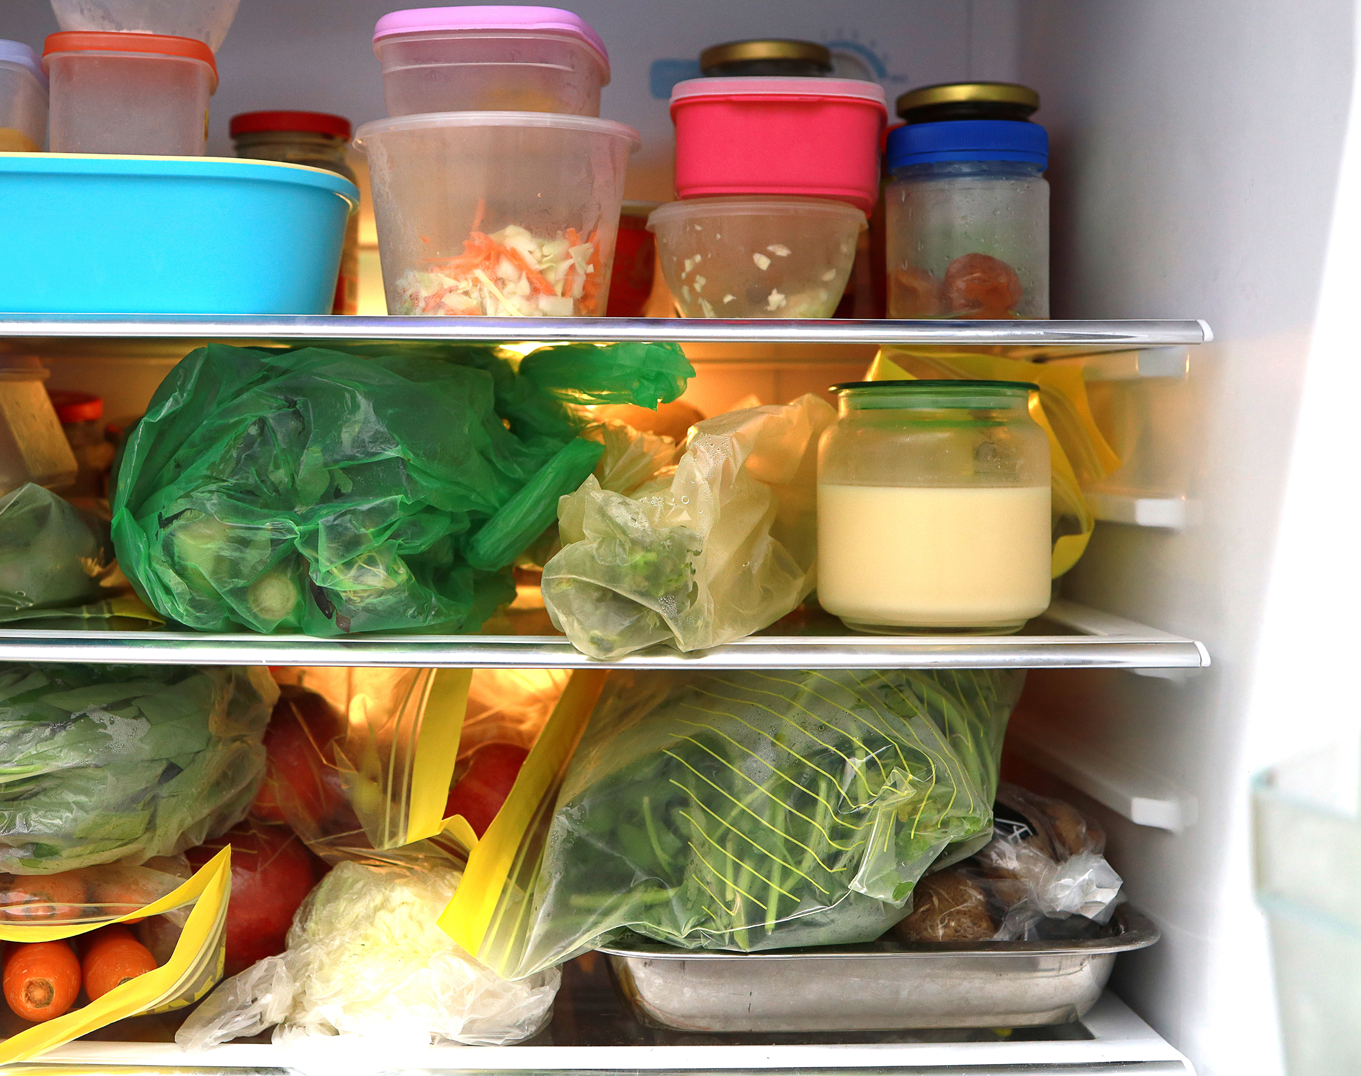
Recommendations
Offer product alternatives
Incorporate shopping list
Product catalogue search
Hide products/categories based on preferences
iDEAL payment integration
Continuous navigation

Slide 7

THANK YOU!

